Slide 1
Lyell Fork Above Ireland

Slide 2
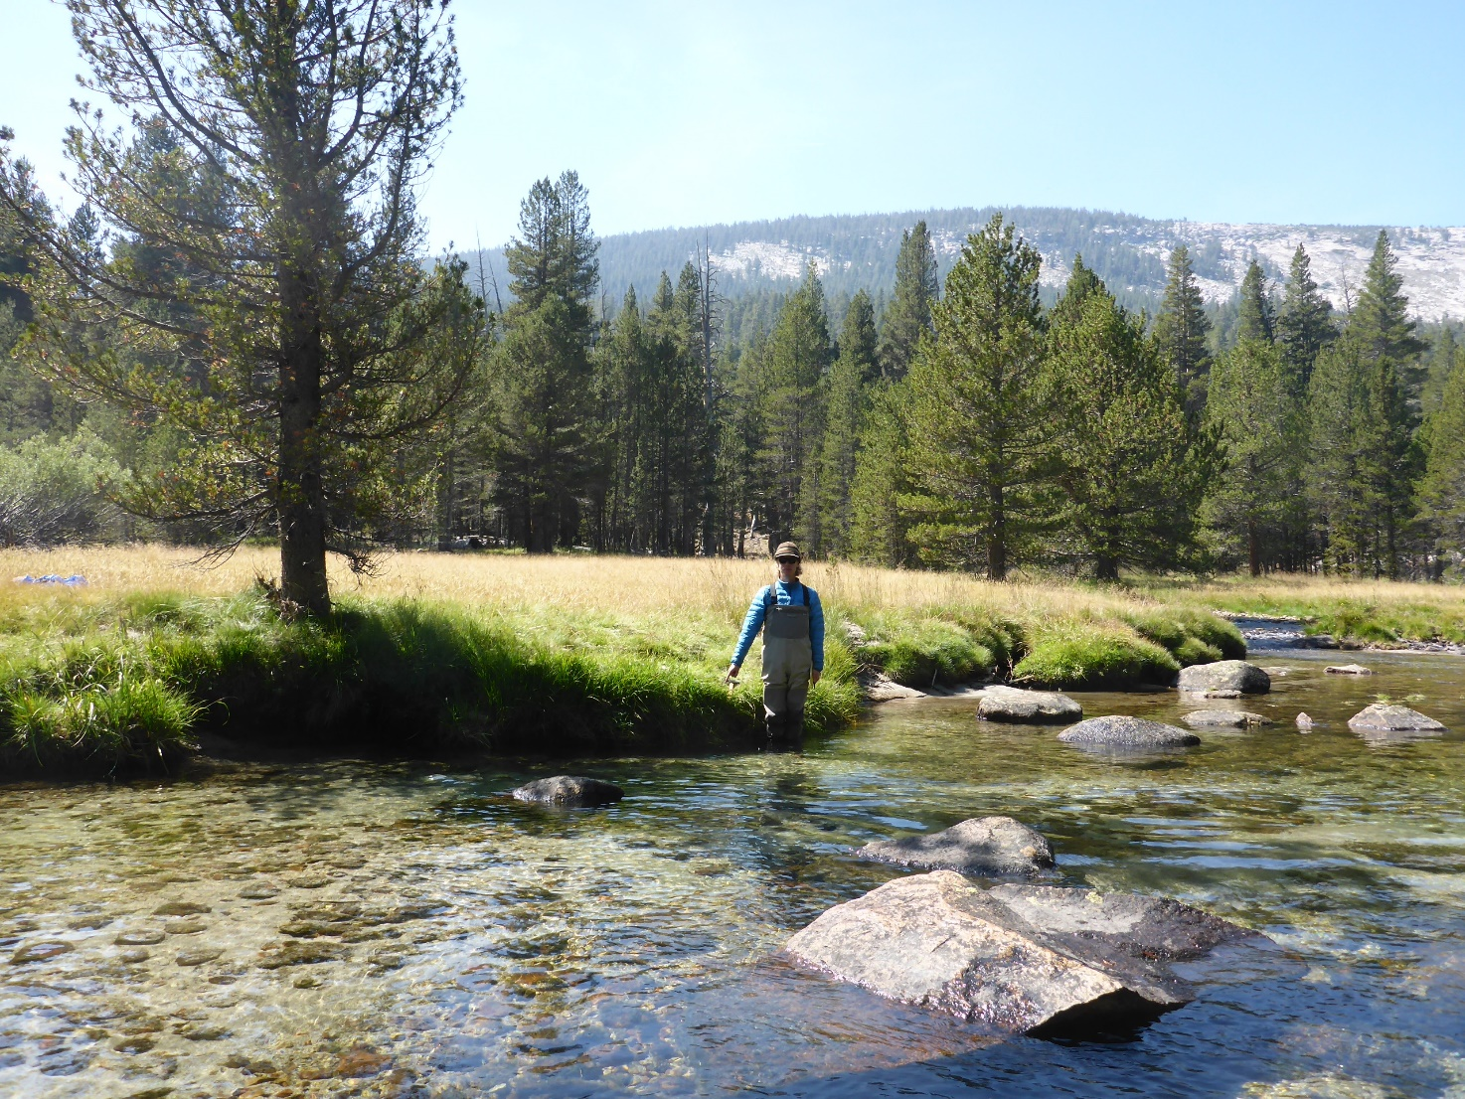
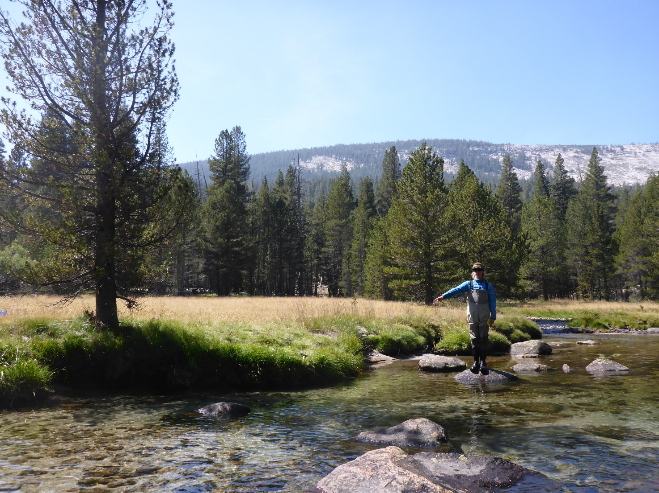
Erik Keenan pointing to the Stilling Tube
Stilling tube is on river left, downstream of tree, just above Ireland Creek. It’s rebared to the streambank.

Slide 3
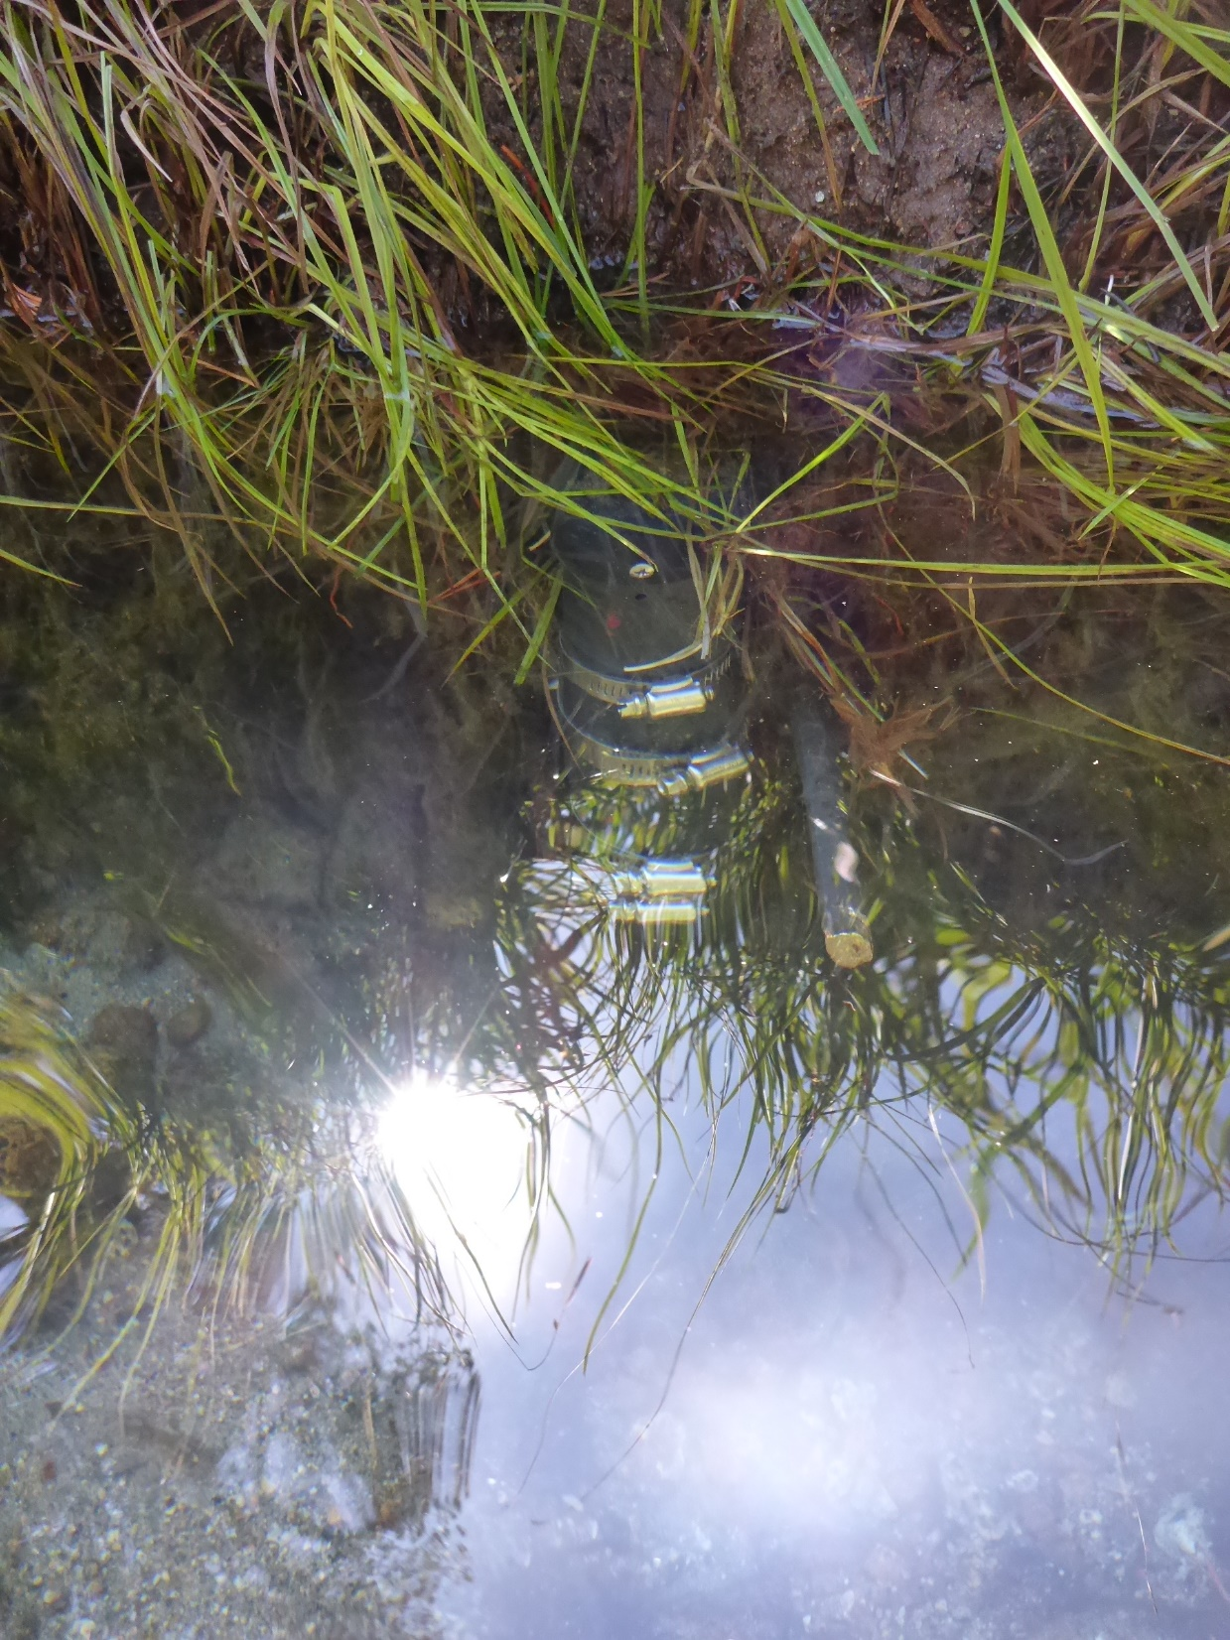
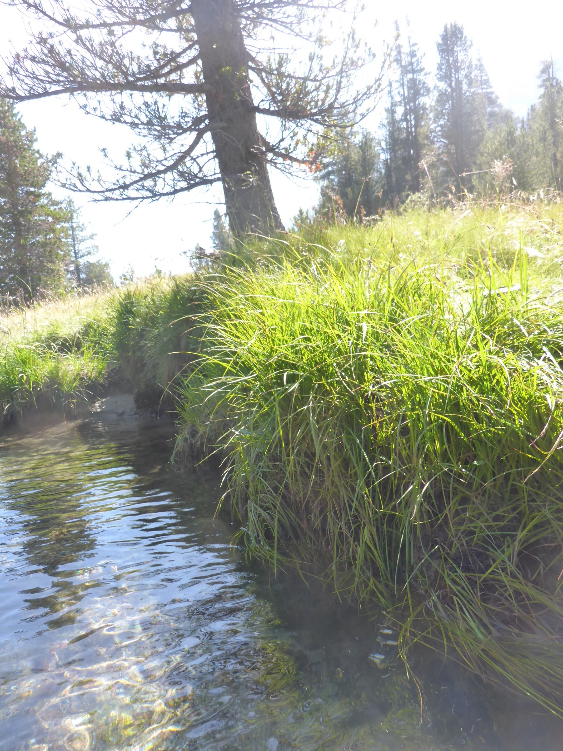
Solinst

Slide 4
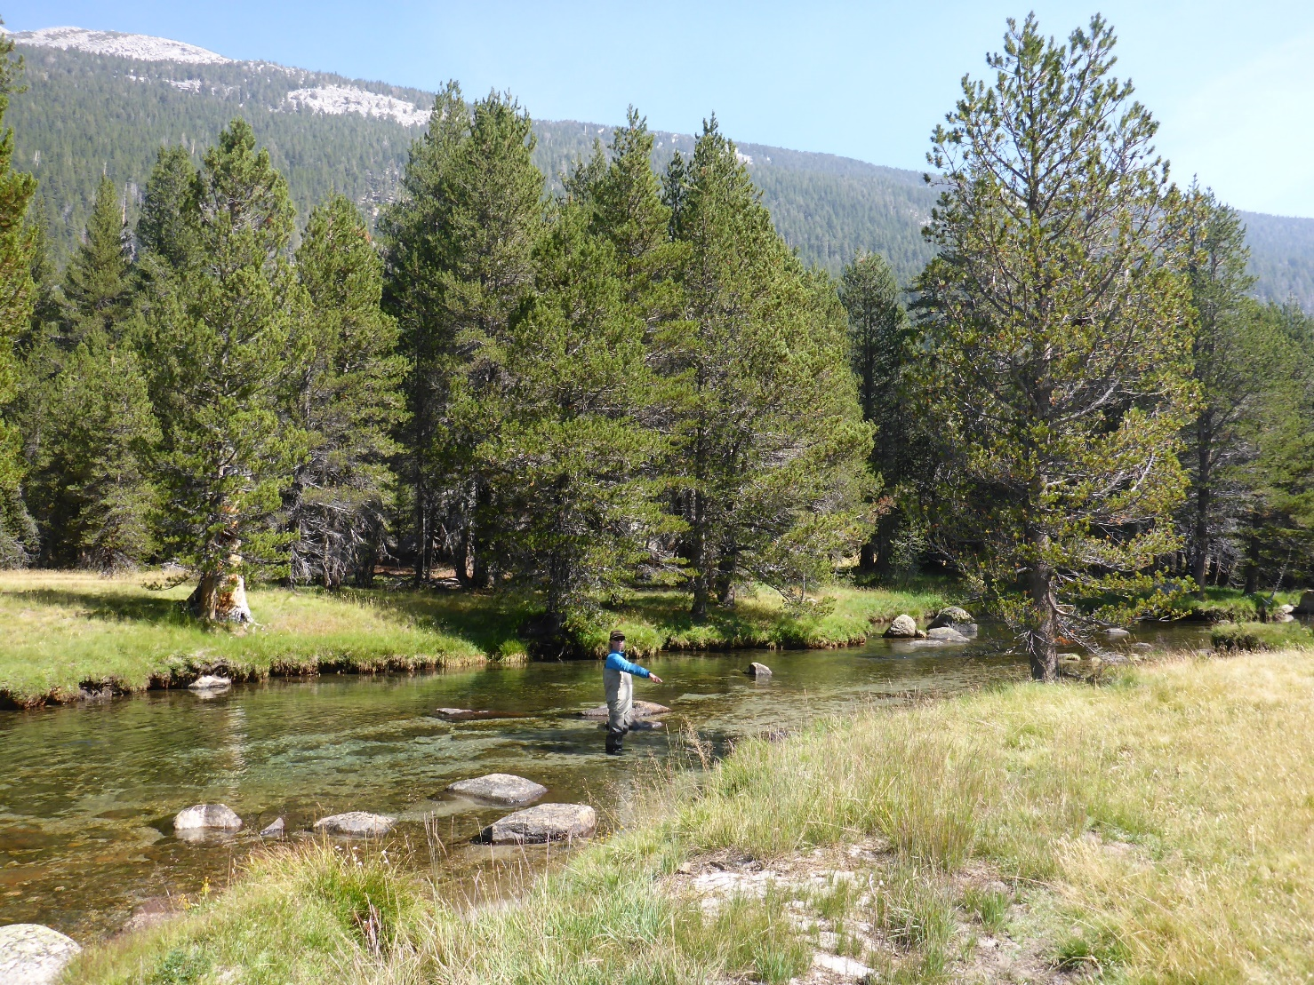
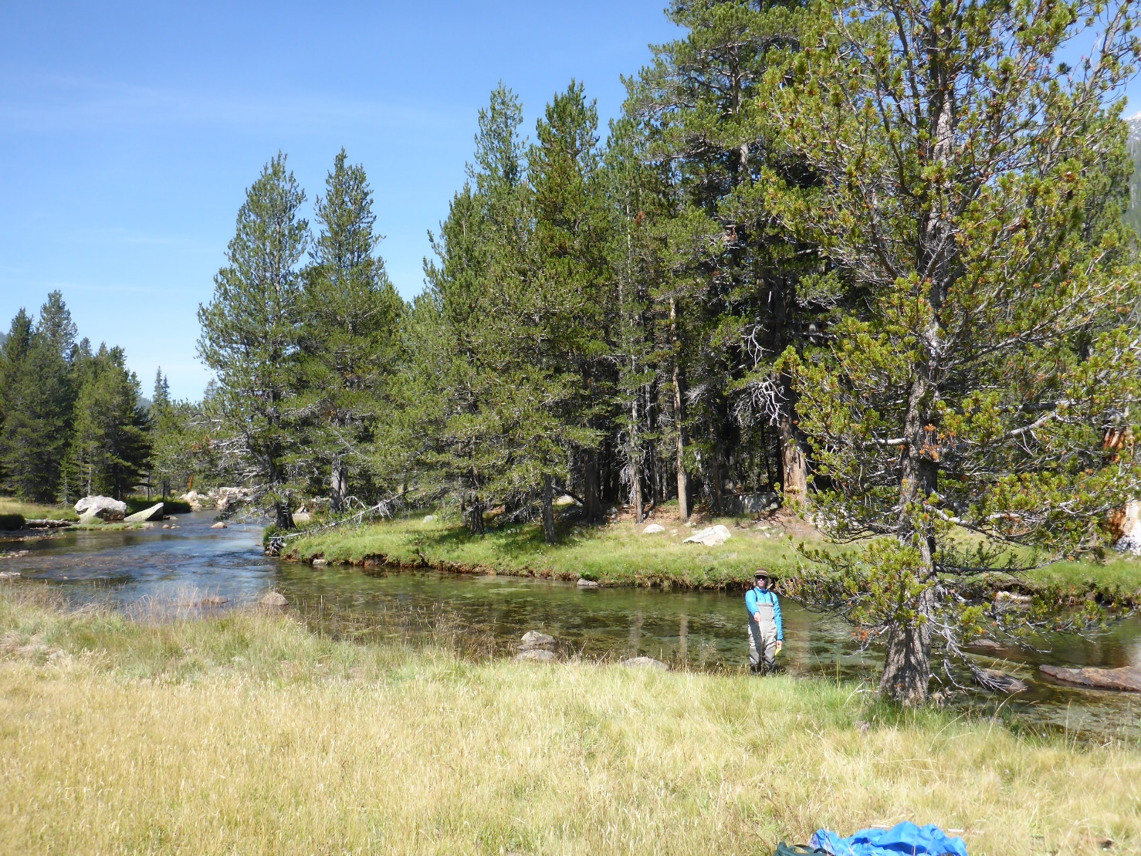
Erick Keenan pointing to the Stilling Tube
Looking downstream

Slide 5
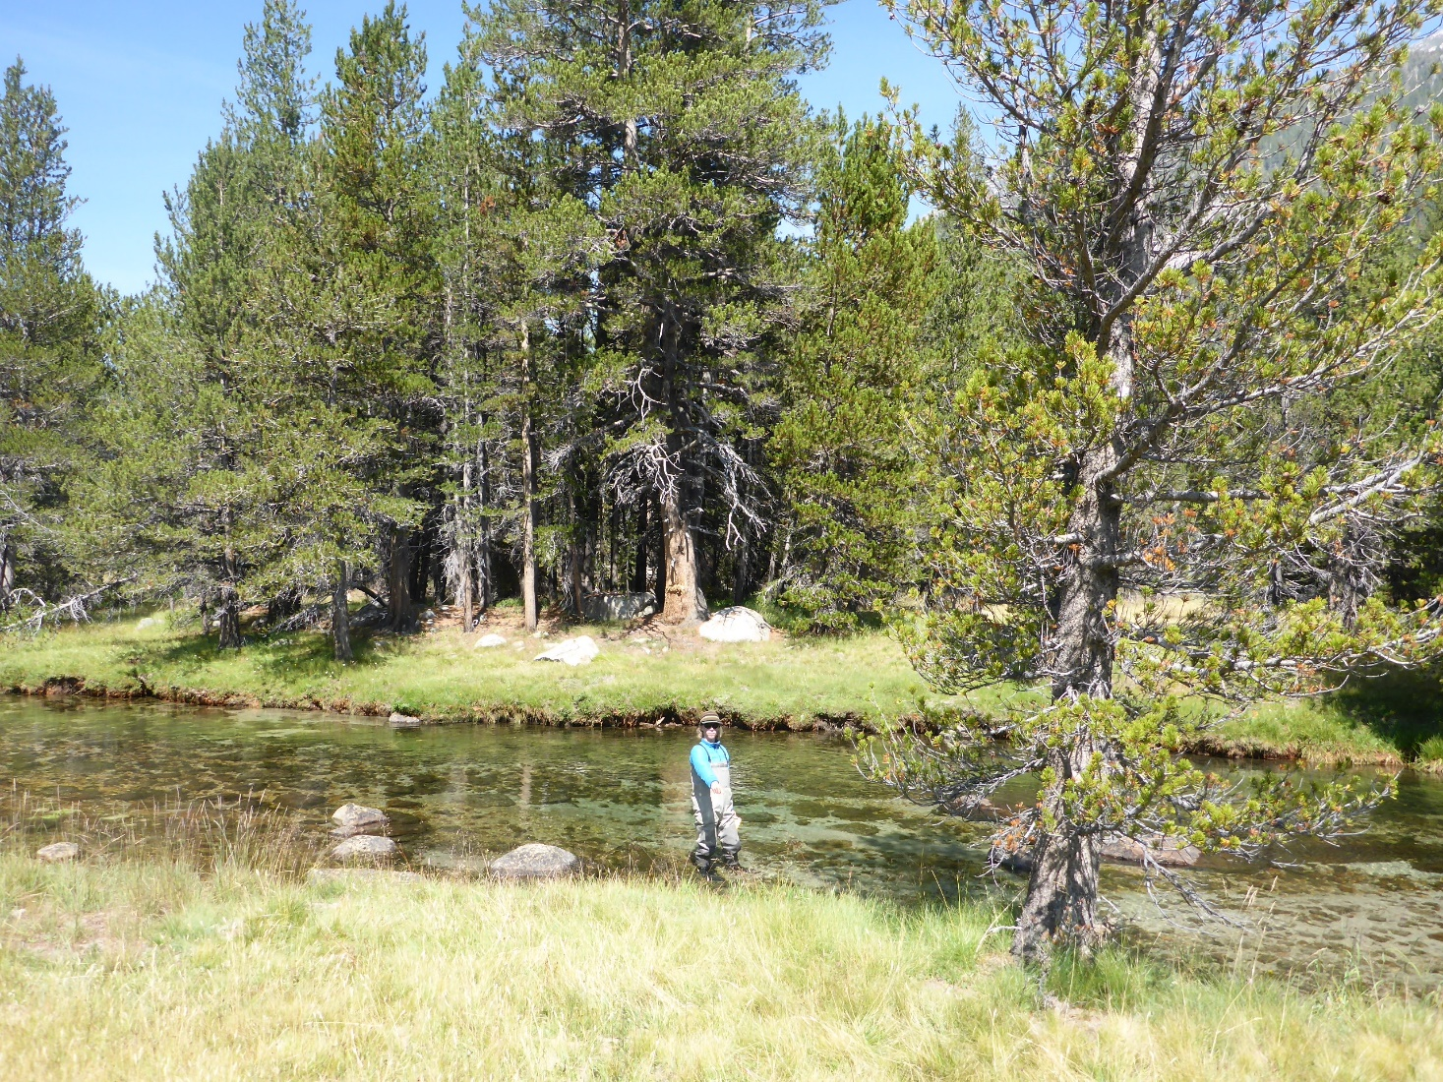
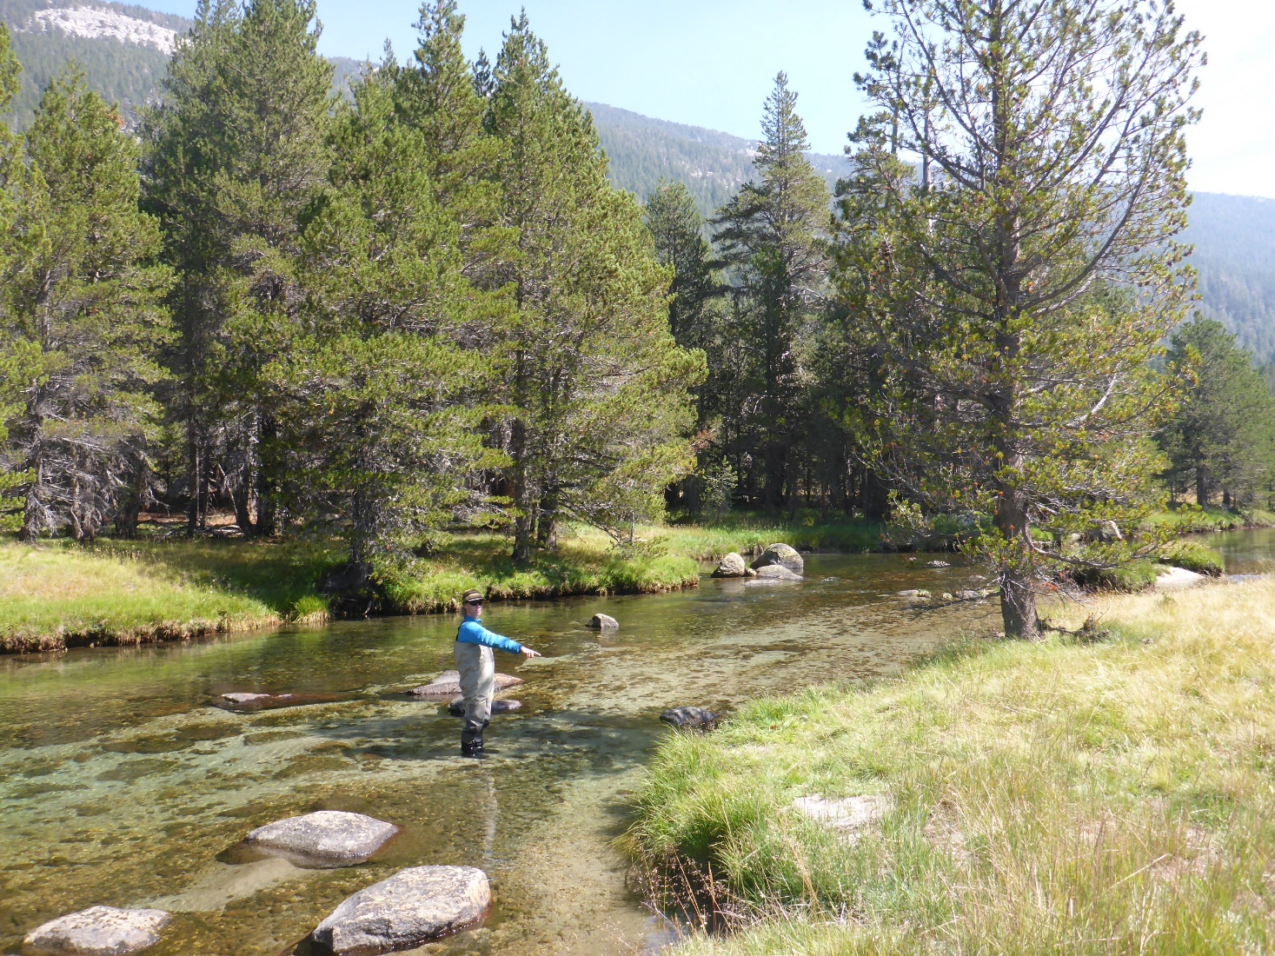
Erick Keenan pointing to the Stilling Tube

